Slide 1
Lending Club Case Study
Priyanka Reddy Aguduri

Slide 2
Objective:
Lending Club company is the largest online loan marketplace, facilitating personal loans, business loans, and financing of medical procedures.
Like most other lending companies, lending loans to ‘risky’ applicants is the largest source of financial loss (called credit loss)
Company wants to understand the driving factors (or driver variables) behind loan default, i.e. the variables which are strong indicators of default. The company can utilize this knowledge for its portfolio and risk assessment.
Identification of such applicant's using EDA is the aim of this case study.

Slide 3
Problem Statement:
Identification of driving factors (or driver variables) behind loan default, i.e. the variables which are strong indicators of default. So that the company can utilize this knowledge for its portfolio and risk assessment.

Slide 4
Analysis Approach :
Data Understanding
Importing the data and gaining knowledge on the data by referring Data Dictionary.
Data Cleaning
Segmented Univariant Analysis
Analyzing the continuous data columns with respect to the categorical Variable
Bivariant Analysis
Recommendation
Analyzing all the plots and providing the recommendations of which columns are driving factors for defaulters
Univariant Analysis
Removing and fixing all the null/Unnecessary columns and rows by checking the impact on analysis, correcting datatype and removing outliers
Analyzing each column by plotting the distributions of each column
Analyzing the two variables to determine relationships between them.

Slide 5
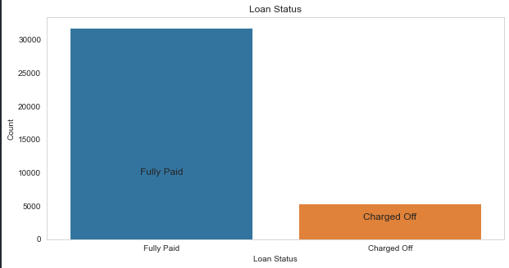
Analysis : Loan Status
Observation:
The number of charged off loan is much smaller(14.5%) of Total count.

Slide 6
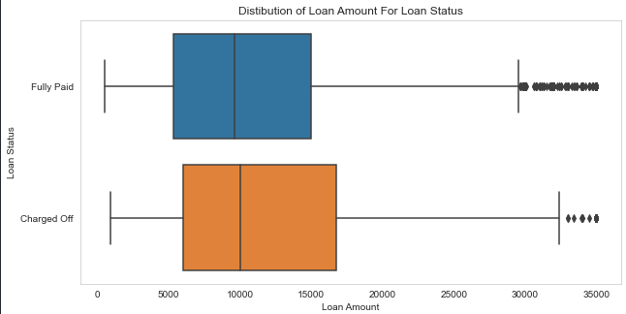
Analysis : Loan Amount
Observation :
Loan amount varies from 500 to 35000 with a median of 10000.
Larger the loan, higher the chance of defaulting.

Slide 7
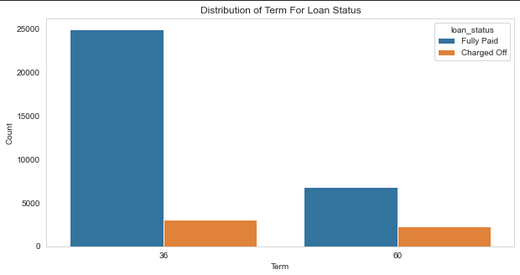
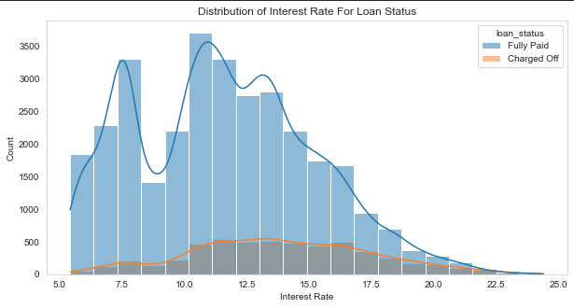
Analysis : Term and Interest Rate
Term : The loan’s taken for 36 months term are much more than 60 months and have lower chance of defaulting.
Interest Rate: The count of loan taken varies with interest rate showing peak around in 5-15 bracket. Chance of defaulting increases with the increase in interest rate.

Slide 8
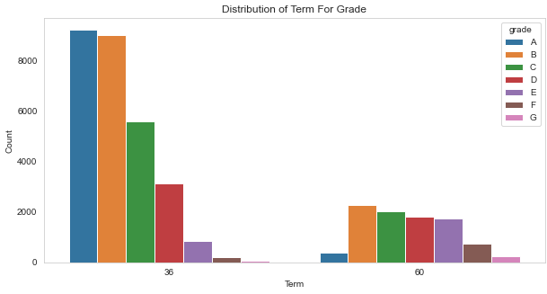
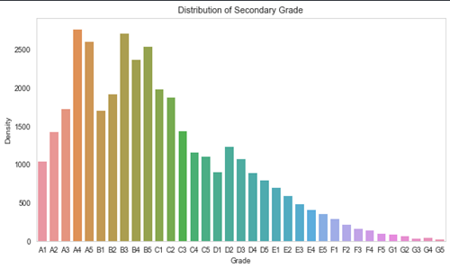
Analysis : Grade and Sub-Grade
Grade: The loan approved are majorly of higher grade as they are of low risk thus low chance of defaulting. 60 months term loans have larger number of lower grade loans with high risk of defaulting
Sub Grade: This provides more insight that the loans within grade are more skewed towards lowered sub grades.

Slide 9
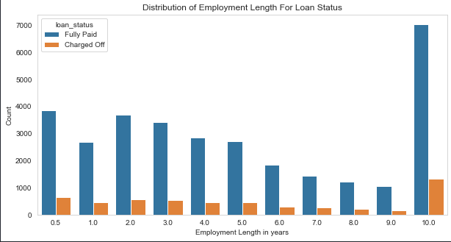
Analysis : Employment Length
Observation:
Majority of clients have 10+ years of experience and has highest number of defaulted loan.

